Slide 1
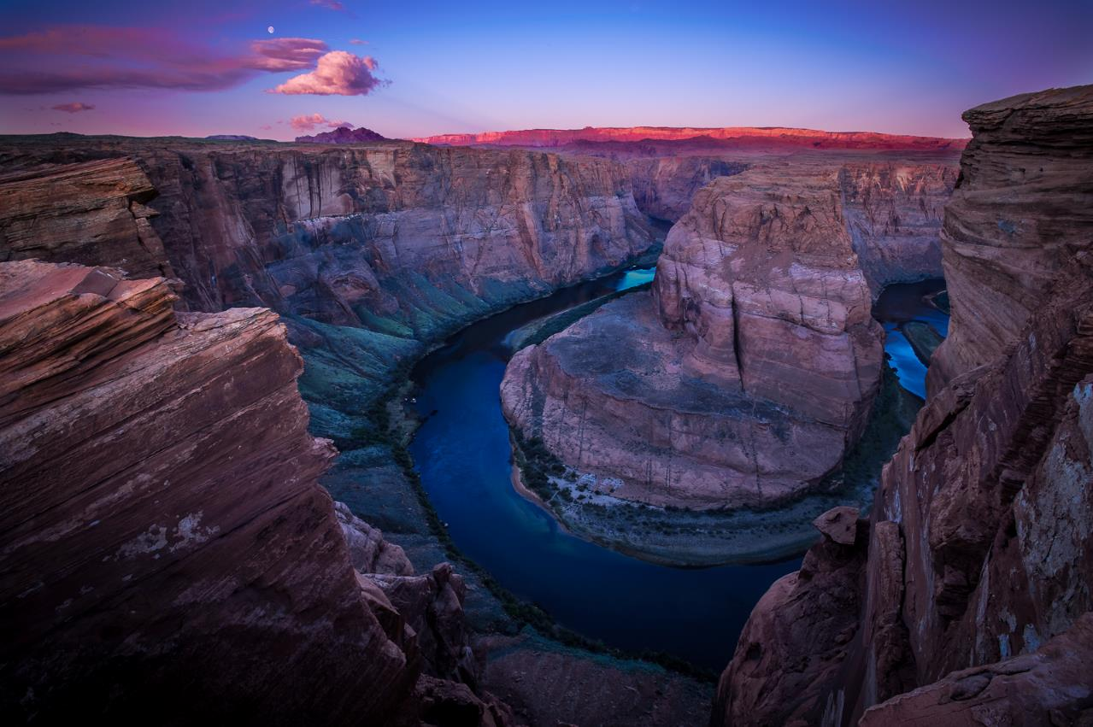
Insights on Customer Attitudes Toward Water
Mitch Tobin
Editor, WaterPolls.org
mitch@seatosnow.com

Slide 2
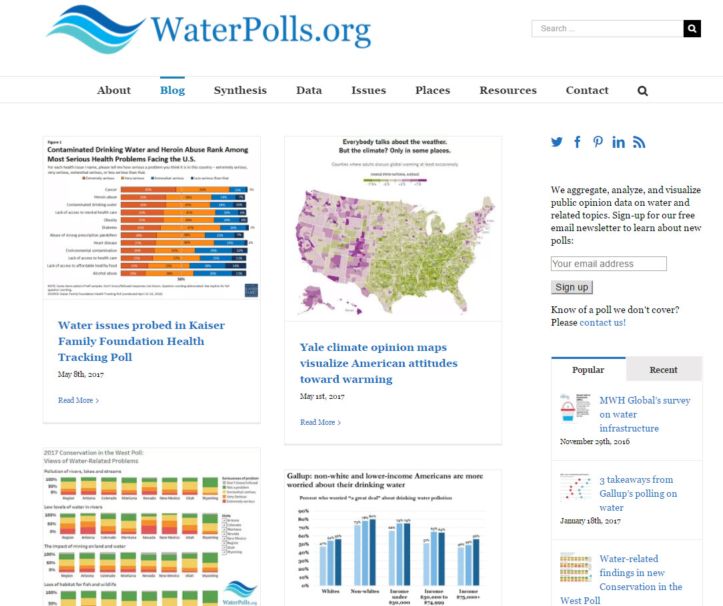

Slide 3
Overview
Americans are very worried about their water
Flint and drought have impacted public opinion
Water is less partisan than many other issues
Many favor conservation and see it as their civic duty
Americans are willing to pay to fix their water infrastructure
Water seen as a good value, but people are wary of rate increases
Communications are critical for recycled water

Slide 4
1) Americans are very worried about their water

Slide 5
Only 1 in 3 Americans drink straight from the tap
What kind of water do you normally drink at home?
Source: February 2016 AP-GfK Poll

Slide 6
Only 1 in 4 Americans know source of their water
Source: March 2011 FM3/POS poll

Slide 7
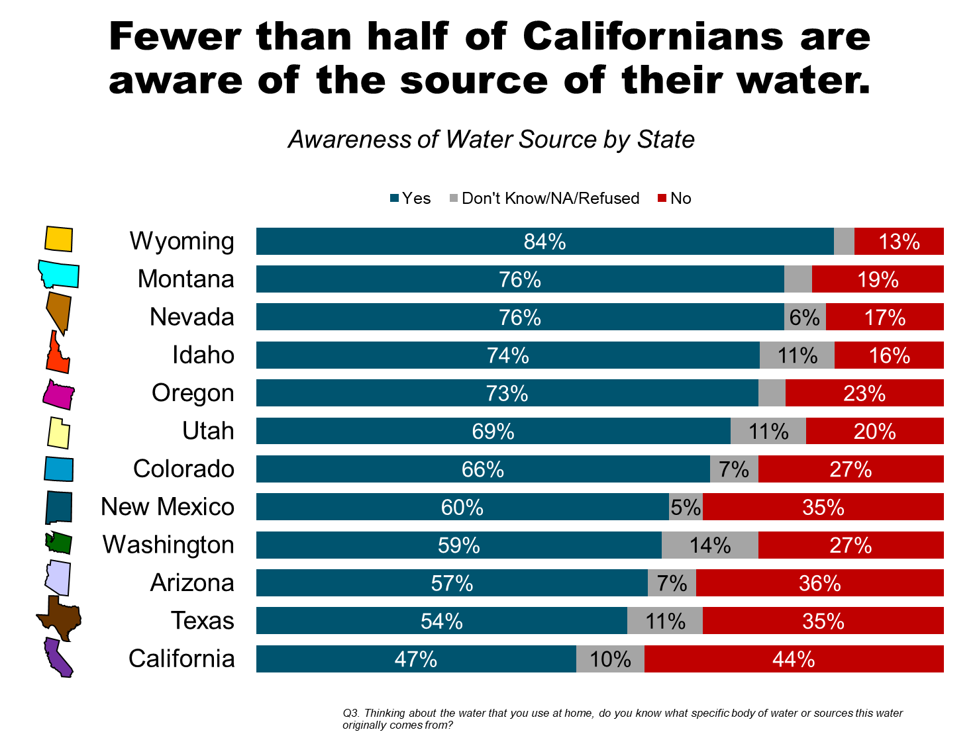
Awareness of water source varies across the West
Source: FM3/POS Sept./Oct. 2017 Water Foundation poll

Slide 8
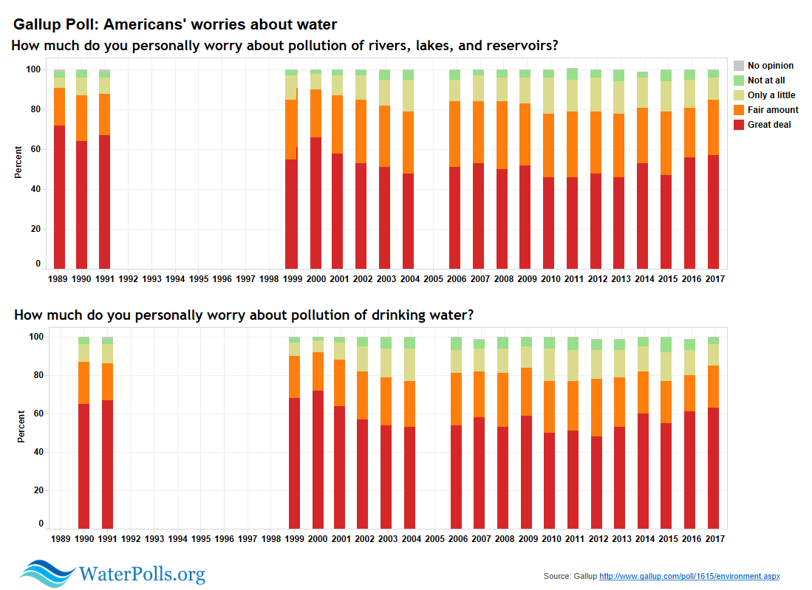
Americans have worried about water for decades
Source: Gallup Poll

Slide 9
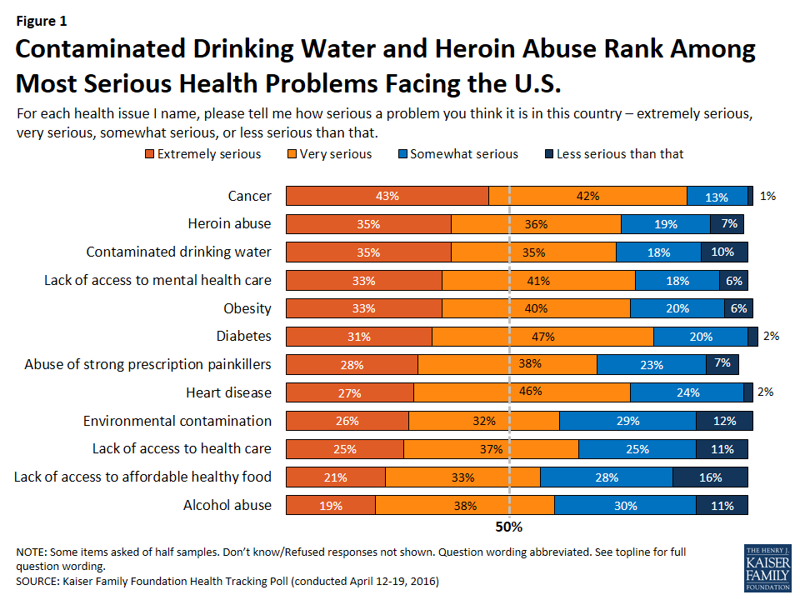
Water pollution rated as serious as heroin abuse
Source: 2016 Kaiser Health Tracking Poll

Slide 10
Non-white, lower-income Americans especially worried
Percent who worried “a great deal” about drinking water pollution
Source: Gallup Poll

Slide 11
2) Flint and drought have impacted public opinion

Slide 12
Many think a crisis like Flint could happen to them
Source: May 2017 Nestlé Waters North America poll

Slide 13
Californians’ views of water supply: 2009-2017
“Would you say that the supply of water is a big problem, somewhat of a problem, or not much of a problem in your part of California?”
Source: Public Policy Institute of California

Slide 14
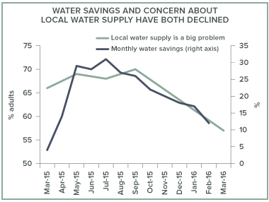
Public opinion impacts water conservation efforts
Source: Public Policy Institute of California

Slide 15
3) Water is less partisan than many other issues

Slide 16
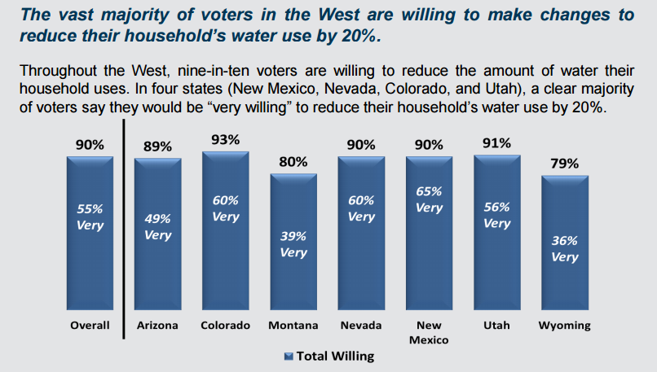
Strong bipartisan support for water conservation
Source: 2016 Conservation in the West Poll

Slide 17
Overwhelming support for fixing water infrastructure
Source: May 2017 Value of Water Campaign poll

Slide 18
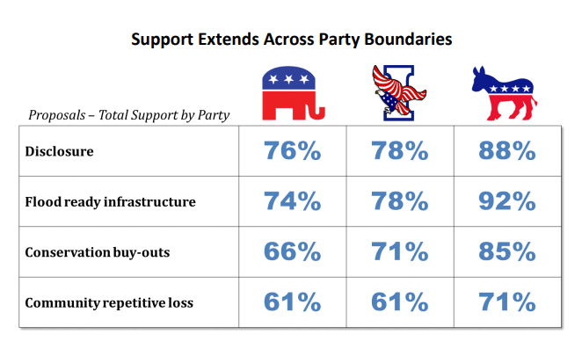
Bipartisan consensus on reforming flood policies
Source: March 2017 Pew Charitable Trusts poll

Slide 19
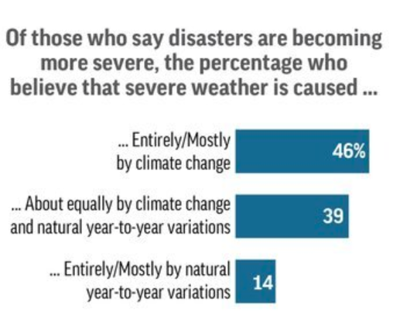
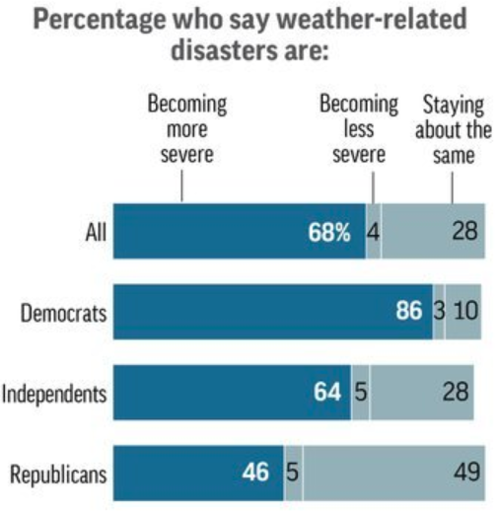
But climate change evokes strong partisan differences
Source: Sept./Oct. 2017 AP-NORC poll

Slide 20
Wide partisan divide over climate change
Source: FM3/POS Sept./Oct. 2017 Water Foundation poll

Slide 21
4) Many favor conservation and see it as their civic duty

Slide 22
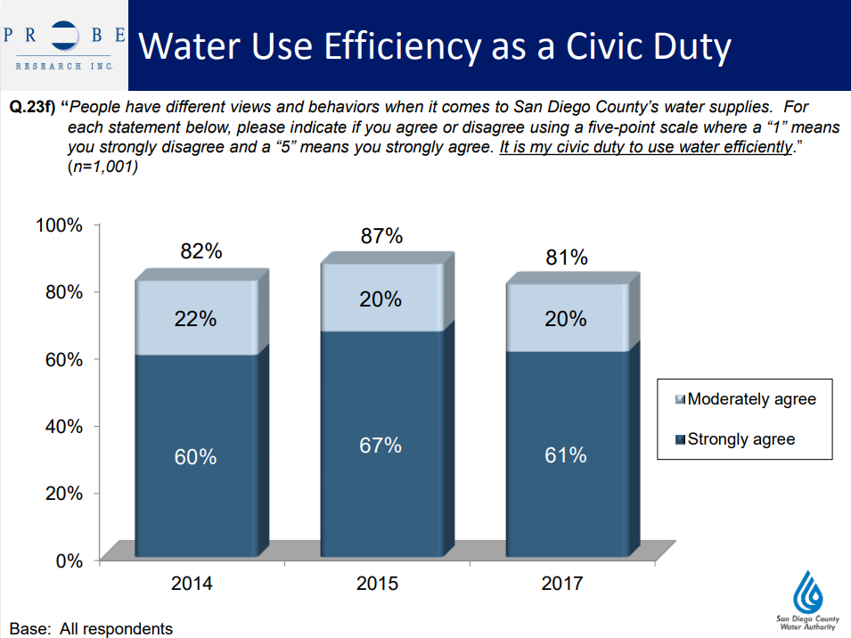
Many people see water conservation as a civic duty
Source: San Diego County Water Authority

Slide 23
Californians’ views on local water conservation efforts
“When it comes to water conservation in your part of California, do you think that your local government is doing too much, the right amount, or not enough?”
Source: July 2017 Public Policy Institute of California Poll

Slide 24
5) Americans are willing to pay to fix their water infrastructure

Slide 25
People may not instantly think of water infrastructure

Slide 26
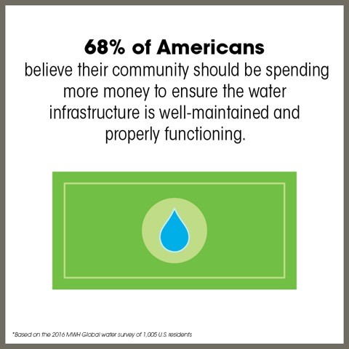
High levels of concern over water infrastructure
Source: 2016 MWH Global water survey

Slide 27
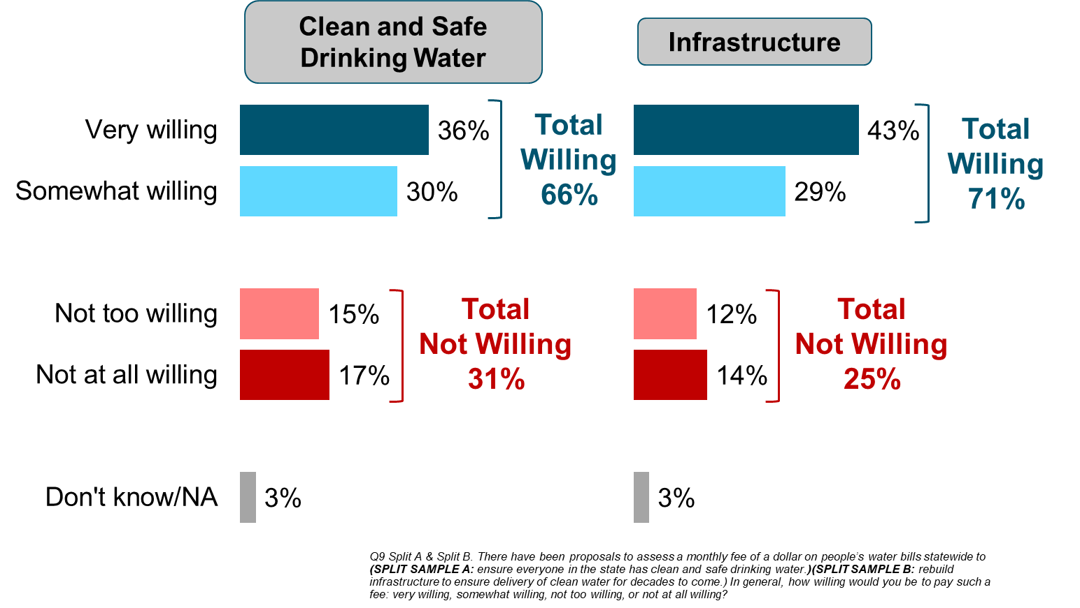
Willingness to pay $1/month for infrastructure, clean water
Source: FM3/POS Sept./Oct. 2017 Water Foundation poll

Slide 28
6) Water seen as a good value, but people are wary of rate increases

Slide 29
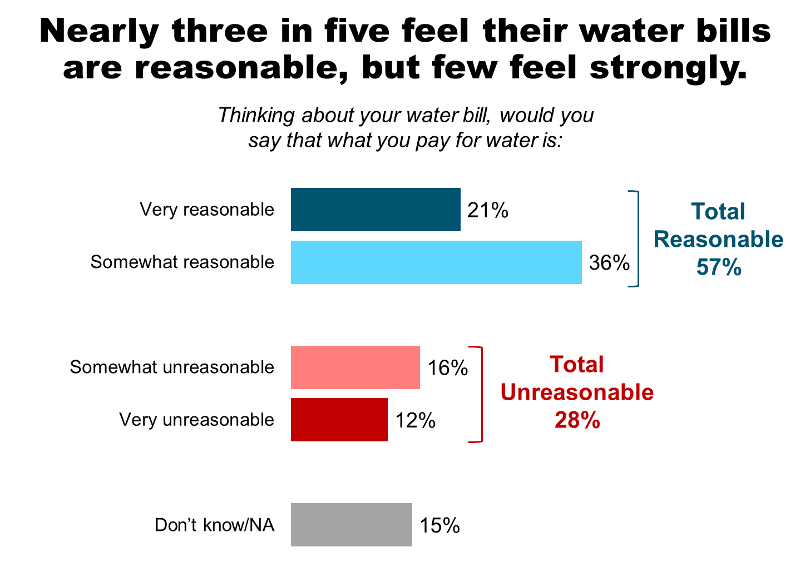
Most Westerners think their water bills are reasonable
Source: Sept./Oct. 2017 Water Foundation poll

Slide 30
Many see water as a good or excellent value
Source: San Diego County Water Authority

Slide 31
Customers are wary of water rate increases
Source: San Diego County Water Authority

Slide 32
7) Communications are critical for recycled water

Slide 33
Recycled water popular in San Francisco Bay Area
The following are potential strategies for improving California’s drought preparedness. For each one, please select if you favor or oppose it.
Source: April 2015 Bay Area Council Poll

Slide 34
Opinion on recycled water depends on intended use
% willing to use recycled water in application
Source: Iris Hui and Bruce Cain, "Overcoming psychological resistance toward using recycled water in California," Water and Environment Journal, Aug. 2017.

Slide 35
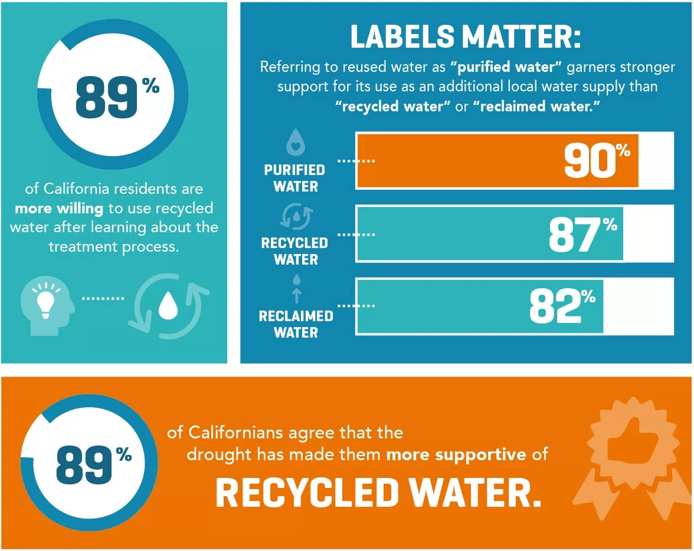
Messaging is critical to views of recycled water
Source: March 2016 Xylem poll

Slide 36
Californians’ views on building desalination plants
“Please say if you favor or oppose the following: building desalination plants on the California coast.”
Source: July 2017 Public Policy Institute of California Poll

Slide 37
Connect with WaterPolls.org
Mitch Tobin
mitch@seatosnow.com
303-330-9487

